Slide 1


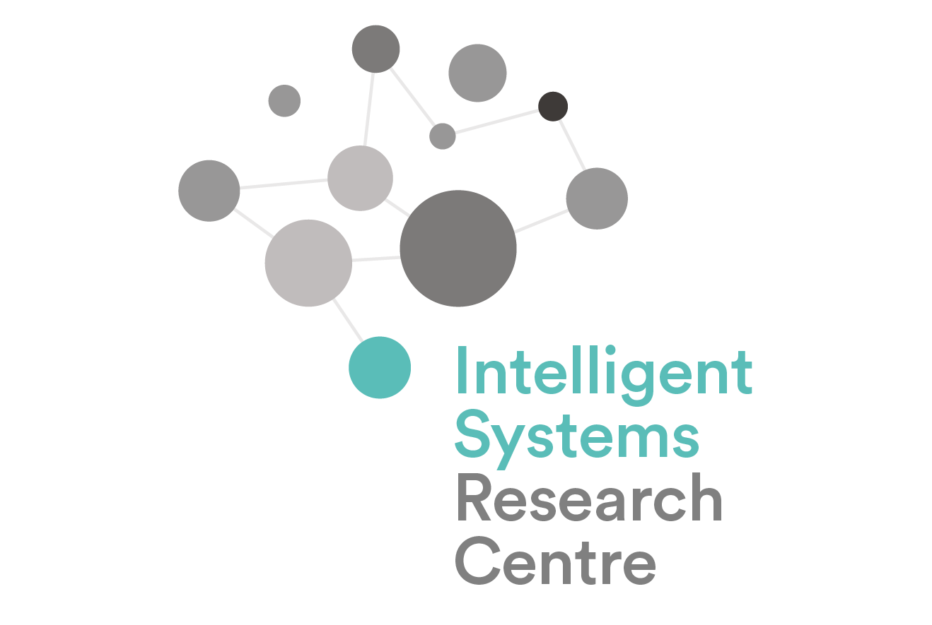







Ulster University Intelligent Systems Research Centre Computational Neuroscience, Neurotechnology & Neuro-inspired AI (ISRC-CN³) Autumn School 24-28 October 2022

Slide 2
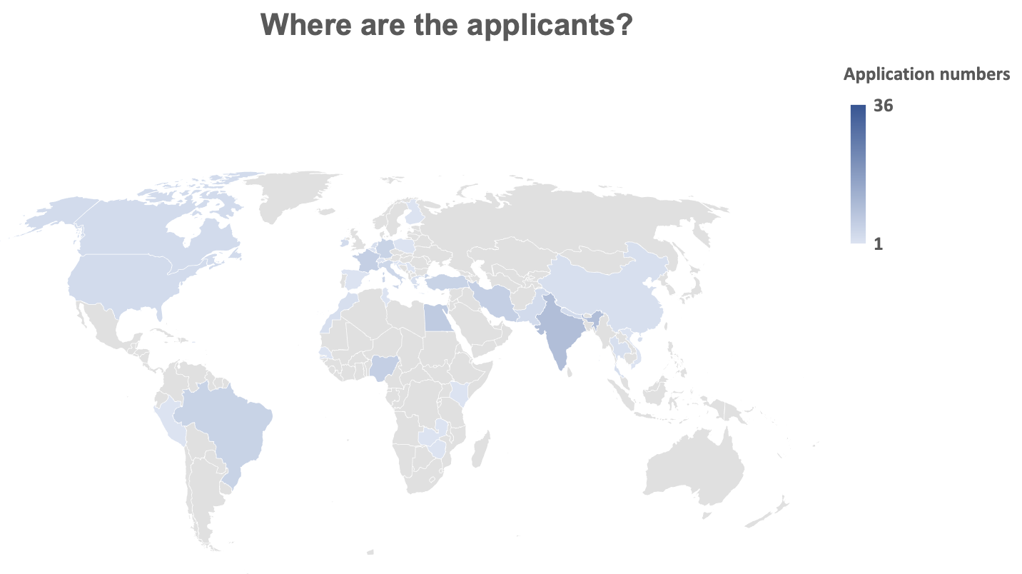
Applicants from 38 countries
Notes:
150 applicants from 38 countries

Slide 3























In-person attendees
Notes:
53 in-person attendees, including internal attendees. 14/15 countries: Republic of Ireland, Northern Ireland, England, The Netherlands, France, Germany, Italy, Poland, India, Pakistan, Tunisia, Egypt, USA, Peru, Nigeria.

Slide 4













































Online attendees
Notes:
Inclusive. 58 online attendees. 21/23 Countries: Republic of Ireland, Northern Ireland, England, Wales, Italy, Spain, Germany, Switzerland, Turkey, Croatia, Serbia, Nigeria, Morocco, Egypt, Iran, India, Brazil, Puerto Rico, USA, China, Nepal, Thailand, Vietnam

Slide 5
Housekeeping
Latest update of the information booklet available on GitHub (https://github.com/ISRC-CN3 )
The GitHub link will be where the Autumn School’s resources will be stored and made available
Join the ISRC-CN3 2022 Slack (https://join.slack.com/t/isrc-cn32022/shared_invite/zt-1fbqlpmo7-lRWB78QvCGkQYUR_OsQg9Q ) for queries, discussions, networking, etc.
Online attendees: Please turn off your microphone when not speaking – use chat box for questions.
Videos of recorded presentations made available at end of day – don’t share to non-attendees
In-person attendees:
On arrival today, please complete registration at Reception
At the foyer, please collect your Intelligent Systems Research Centre (ISRC) card (to get in and out of buildings and rooms) and other packages
Each morning, please sign-in at the foyer of the ISRC building and sanitize your hands when entering the building - there is a booklet near the window for signing
External visitors please obtain WIFI guest account via Eoghan (pronounce “Owen”) Tucker, and temporary username and password from IT Staff for accessing computers in our computer lab for the lab sessions
Coffee & tea breaks and lunches will be provided and held at the dining room in ground floor of ISRC, and on Day 3 at the Minor Hall (at MD building) during campus tour
Dinners will be provided on Day 1 and Day 2 tea/dining room in ground floor of ISRC, after lab sessions
Thursday (27th October) dinner will be held at Bishop’s Gate Hotel, Derry, at 7:30pm

Slide 6


Join as member
IEEE Circuits and Systems Society
IEEE Computational Intelligence Society
IEEE Computer Society
IEEE Electron Devices Society
IEEE Engineering in Medicine and Biology Society
IEEE Magnetics Society
IEEE Signal Processing Society
IEEE Solid-State Circuits Society
IEEE Systems, Man, and Cybernetics Society
Become part of the world of computational intelligence! Benefit from the many opportunities of expanding and updating your knowledge, sharing results of your activities, developing new knowledge and professional practices, networking with your peers, and promoting your career.

Slide 7


Join as member
Northern Ireland
Local Group
https://www.bna.org.uk/
https://neuroscienceireland.com/
Contact: Elaine Murray (e.murray@ulster.ac.uk), Ulster University

Slide 10

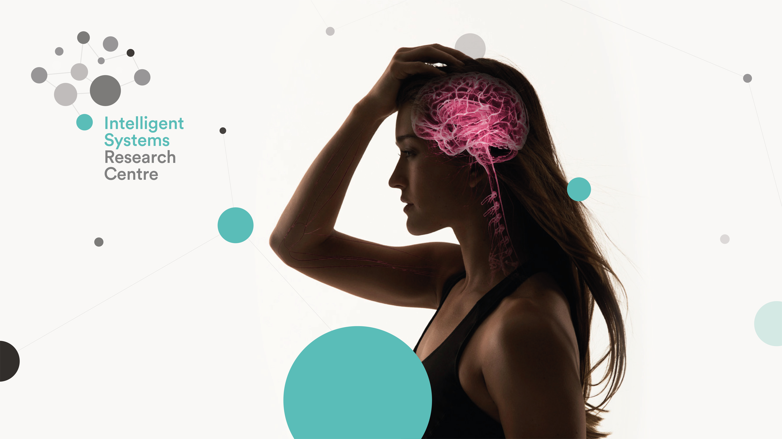









Vision
Our vision is to develop a bio-inspired computational basis for Artificial Intelligence.
Director, Prof Damien Coyle
Professor of Neurotechnology
Turing AI Fellow 2021-2025
Intelligent Systems Research Centre
Magee Campus | Derry | BT48 7JL
T: +44 (0)28 7167 5170
E: dh.coyle@ulster.ac.uk
W: www.ulster.ac.uk/irsc
Intelligent Systems Research Centre
Research Themes
CARL
Cognitive Analytics Research Lab
CIDRA
Centre for Industrial Digitisation and Robotics Automation
Facilities
Northern Ireland Functional Brain Mapping facility houses the only magnetoencephalography
(MEG) system in Ireland
Brain-Computer Interface Lab
Magnetic Shielded Rooms x 2
Advanced Cognitive Robotics lab
Spatial Computing & Neurotechnology
Innovation Hub for next generation computing
and human computer interaction

Slide 11
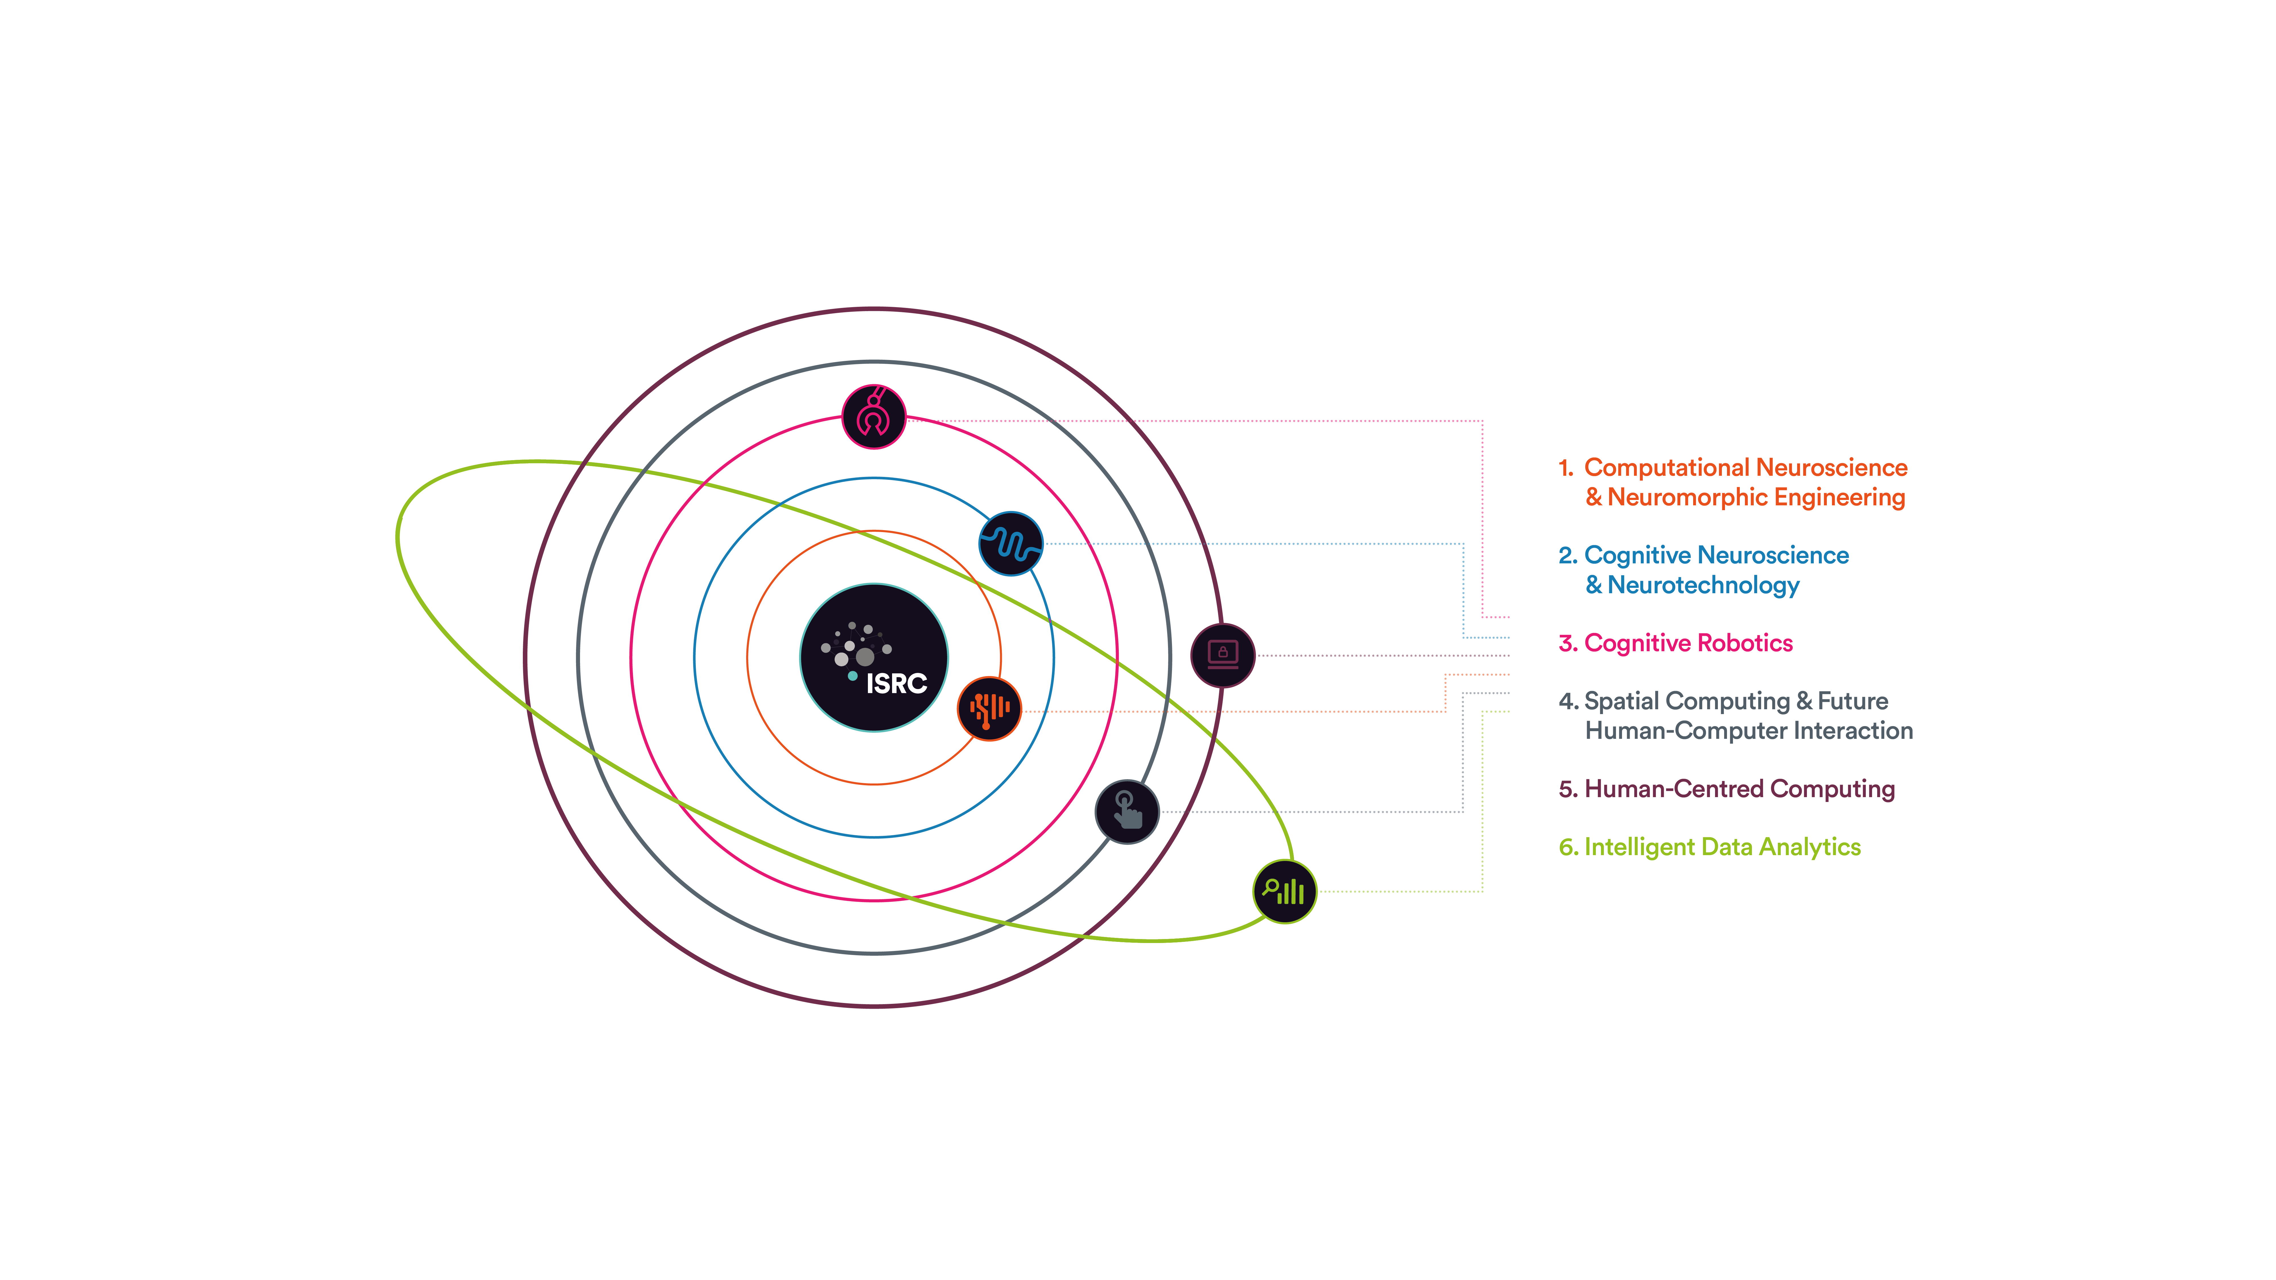

Slide 12
Upskilling “Brain and AI” focused researchers
Targeting PhD researchers and early career researchers and developers
Improve timely project/PhD programme completions – those that require knowledge from multiple disciplines
Covering a broad range of interlinked topics quickly
Enable more confidence in research beyond your discipline and across multiple disciplines
Showcase ISRC research and emphasise our openness for collaboration
Building networks and collaboration partners – learning from others

Slide 13


